Slide 1
95-889 Final Project:
Honeypot
Nora Murray
4/30/2020
Carnegie Mellon University
nmurray@Andrew.cmu.edu

Slide 2
Agenda
Problem Scope
Methodology
Results
Limitations
Future Work
Conclusion
Questions

Slide 3
Problem Scope
Outside of the InfoSec community, there is a lack of awareness, knowledge and concern for cyber threats. The lay person view of security presumes security through obscurity.
A common thought about security is:
“Who would want to attack me?!”
“What are they doing?!”
“How can I prevent this?”
This presentation seeks to provide some context to the first question.
Notes:
People outside

Slide 4
Methodology: Honeypot Configuration
Honeypot Source: https://github.com/mattymcfatty/HoneyPi
This honeypot captures activity on:
Port Scanning Activities
FTP Connection Attempts
Telnet Connection Attempts
VNC Connection Attempts

Slide 5
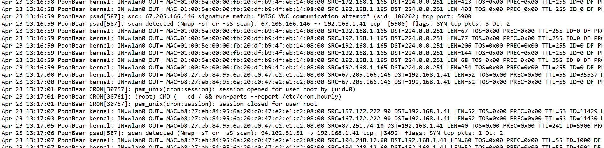

Methodology: Honeypot Configuration
This honeypot captures activity on:
Port Scanning Activities
FTP Connection Attempts
Telnet Connection Attempts
VNC Connection Attempts
Notes:
cron is a time-based job scheduler in Unix-like computer operating systems
In computing, Virtual Network Computing (VNC) is a graphical desktop-sharing system that uses the Remote Frame Buffer protocol (RFB) to remotely control another computer. (Remote code execution)
Observe Port scanning, observe that someone is trying to log in and run a report on my cron logs
Nmap scans are detected

Slide 6
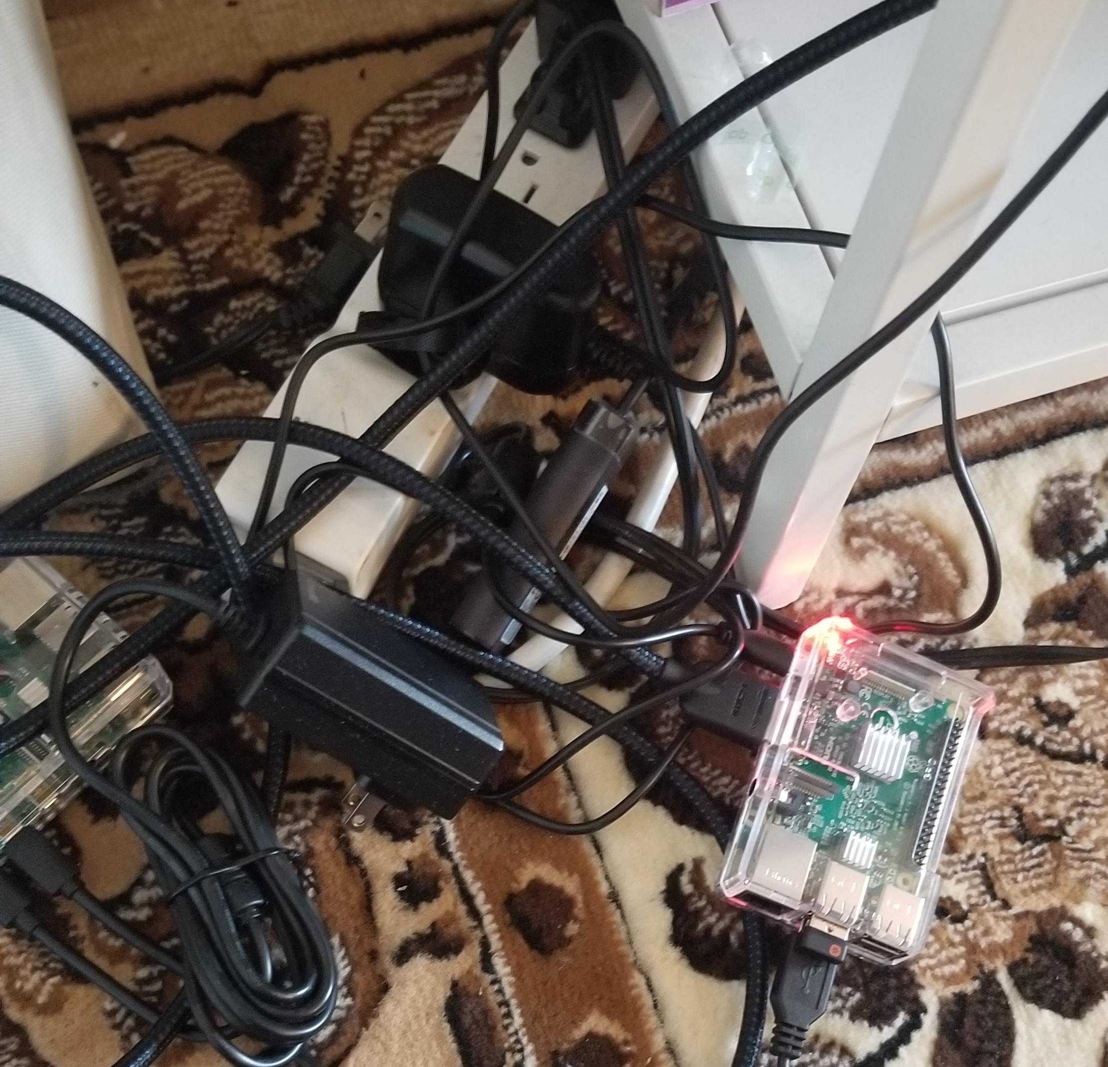
Methodology:
Devices:
Raspberry Pi 3B with Buster installed
Router, connected via WiFi
500 MB external hard drive
32 GB SD card
Software:
Python packages:
numpy, pandas, collections, matplotlib,
json, datetime
Tableau

Slide 7
Methodology:
Used the standard prompts from HoneyPi to install
Used journalctl to save and store logs to an external hard drive
Parsed the logs file using python
Collected 2 log files:
Log File collected from April 7, 2020 - April 14, 2020
Log File collected from April 23 - April 30, 2020
Github: https://github.com/normur/ATA_honeypot
Notes:
Second file: Keeps crashing on google colab because I keep running out of RAM
Each of these log files is approximately 500 MB, so when visualizing, sometimes, less data is cleaner output

Slide 8
Methodology:
Collected over 30,000 unique IP addresses
Used Grey Noise
Used journalctl to save and store logs to an external hard drive
Parsed the logs file using python
Visualized in Tableau and Jupyter Notebook
Notes:
Second file: Keeps crashing on google colab because I keep running out of RAM
Each of these log files is approximately 500 MB, so when visualizing, sometimes, less data is cleaner output

Slide 9
Methodology:
Honeypot Selection and Set Up
Log Collection
Parse Logs
Analysis
Visualization
Prioritized selecting a honeypot for ease of setting up and type of data collected
Log files were saved using journalctl and collected in 2 iterations: first between April 7-14, 2020, and April 23 - 30, 2020 for a total of 14 days of logs
Parsed in python.
Recommendation: Control what is saved in logs and in which format. In the future, I would probably store these logs as jsons.
Two Parts:
Exploratory data analysis in a Jupyter notebook
Manual research of selected domain names
Use matplotlib and tableau to create interactive maps to answer the question of “who” is scanning my honeypot. .
Notes:
Second file: Keeps crashing on google colab because I keep running out of RAM
Each of these log files is approximately 500 MB, so when visualizing, sometimes, less data is cleaner output

Slide 10
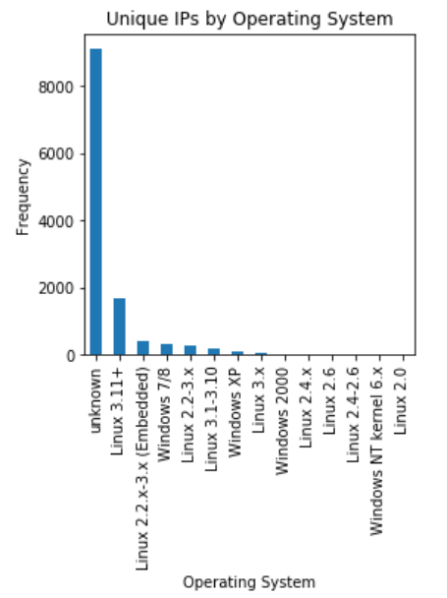
Results
31,138 unique IP addresses from the honeypot logs
22,791 unique IP addresses from Grey Noise
115 different countries
Scans are primarily coming from other Linux or Windows operating systems
Detected 0 iOS
Graphed in interactive dashboard in Tableau:
https://public.tableau.com/views/HoneypotVisualizations/DomainAnalysis?:display_count=y&publish=yes&:origin=viz_share_link

Slide 11
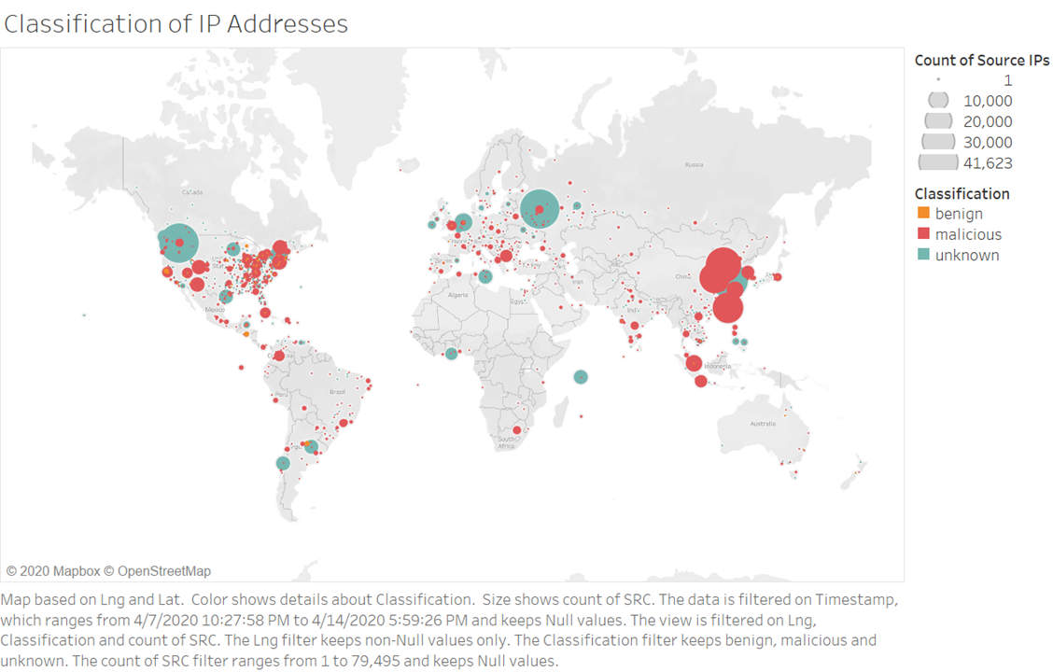
Results

Slide 12
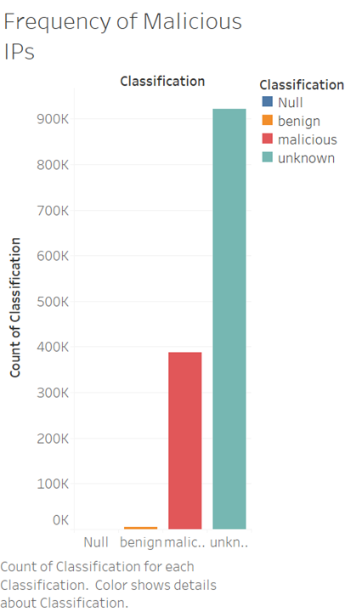
Results
Grey Noise is an excellent but limited tool
Assume that tools used by security professionals are biased toward finding threats rather than benign IPs
Notes:
NON unique

Slide 13
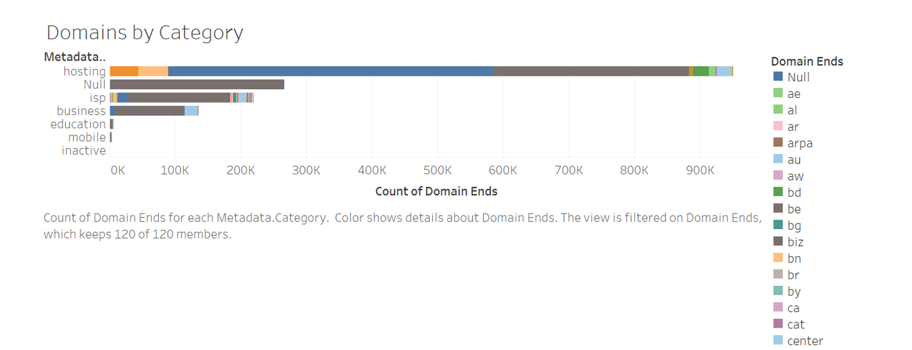
Results
Notes:
Most domains are coming from hosting services, as you might expect

Slide 14
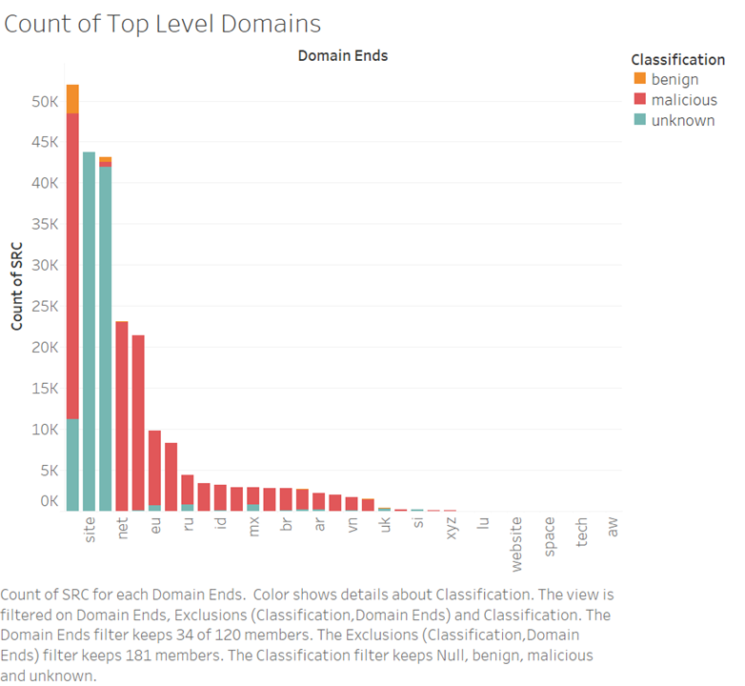
Results
Results from the domain analysis show that Russia and China are relatively high, but there are a few surprising results.
Again, most of the metadata did not include this.
Ireland (.ie)
Russia (.ru)
China (.cn)
Notes:
.com , .site. .org
'nan': 19616, -- NOt included

Slide 15
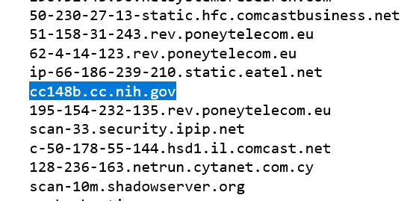

Results: Interesting Domains
Given my honeypot collection logs in April, is this a result of this security breach disclosed on April 22, 2020?

Slide 16
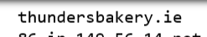
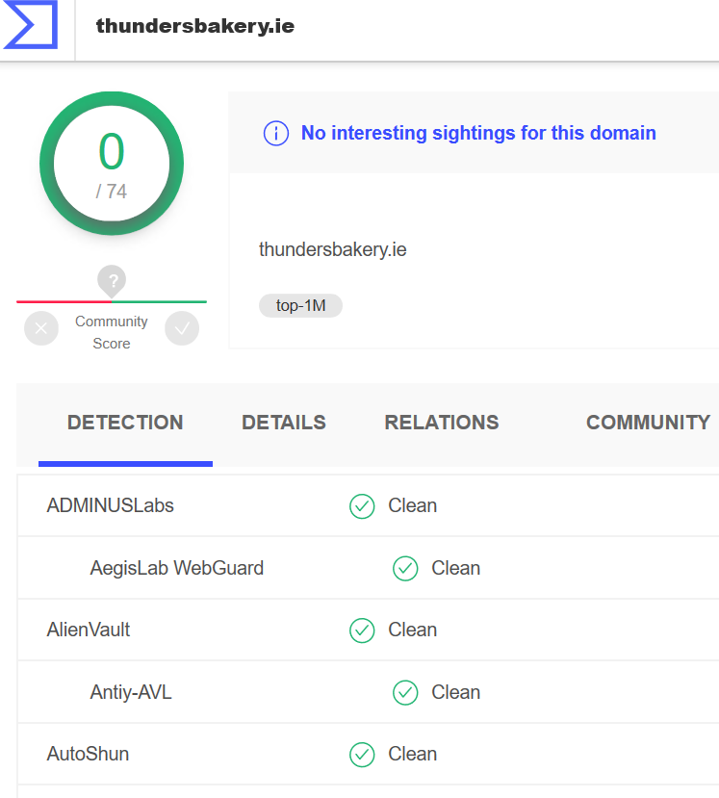

Results: Interesting Domains
What purpose does a bakery in Dublin have to be port scanning?

Slide 17
Limitations
Data Collection
Visualizations are limited to those IP addresses that could be identified by GreyNoise and have City/County data
(Free) GIS information for coordinates by city-name is typically limited to larger top tier cities.
GreyNoise shows only what is already known

Slide 18
Future Work
“What are they doing?!”
How many attempted remote code executions?
Which ports are attackers targeting?
Which ports are being scanned?
What are the attack vectors?

Slide 19
Future Work
“How can I prevent this?”
GreyNoise shows only what is already known.
Could use GreyNoise data as a labeled training set to predict which predict which IPs are malicious
Similar methodology to what most SIEM tools use
Potentially use this as a machine learning model for a SIEM tool for your honeypot

Slide 20
Conclusions
When it comes to answering the question “Who would want to attack me?!” we observe some the expected players: Russia, China, and malicious IPs from generic hosting services.
Situational awareness of what is happening on your own network is critical to keeping your own devices secure and creating a prevention plan

Slide 21
Questions?

